Slide 1
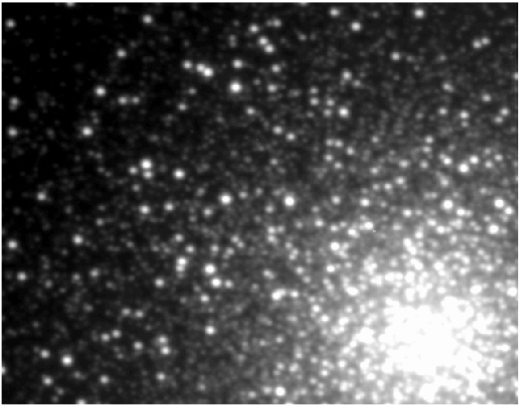
National Science Olympiad
Astronomy C Event 2014
Stellar Evolution and Variable Stars

Slide 2
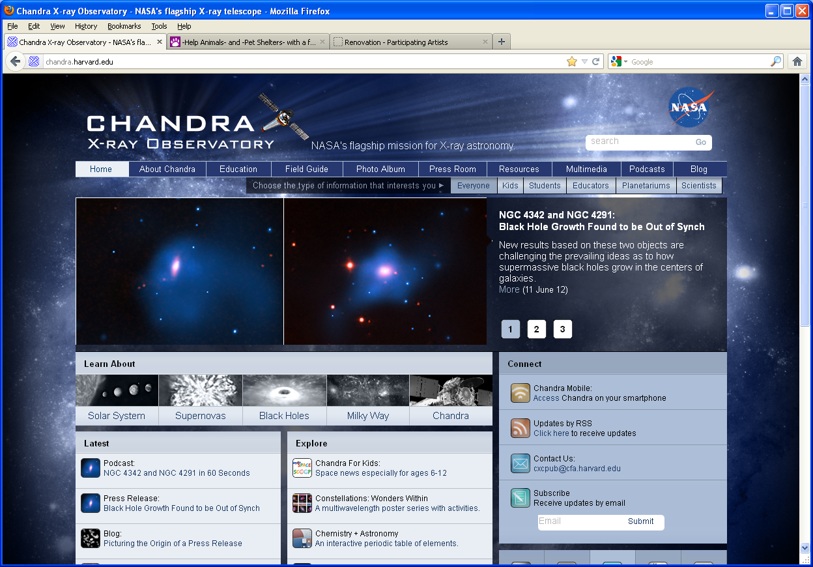
Chandra X-Ray Public Outreach Office
Donna Lee Young, NSO Astronomy Event Supervisor – donna@aavso.org
Tad Komacek – tkomacek@gmail.com

Slide 3
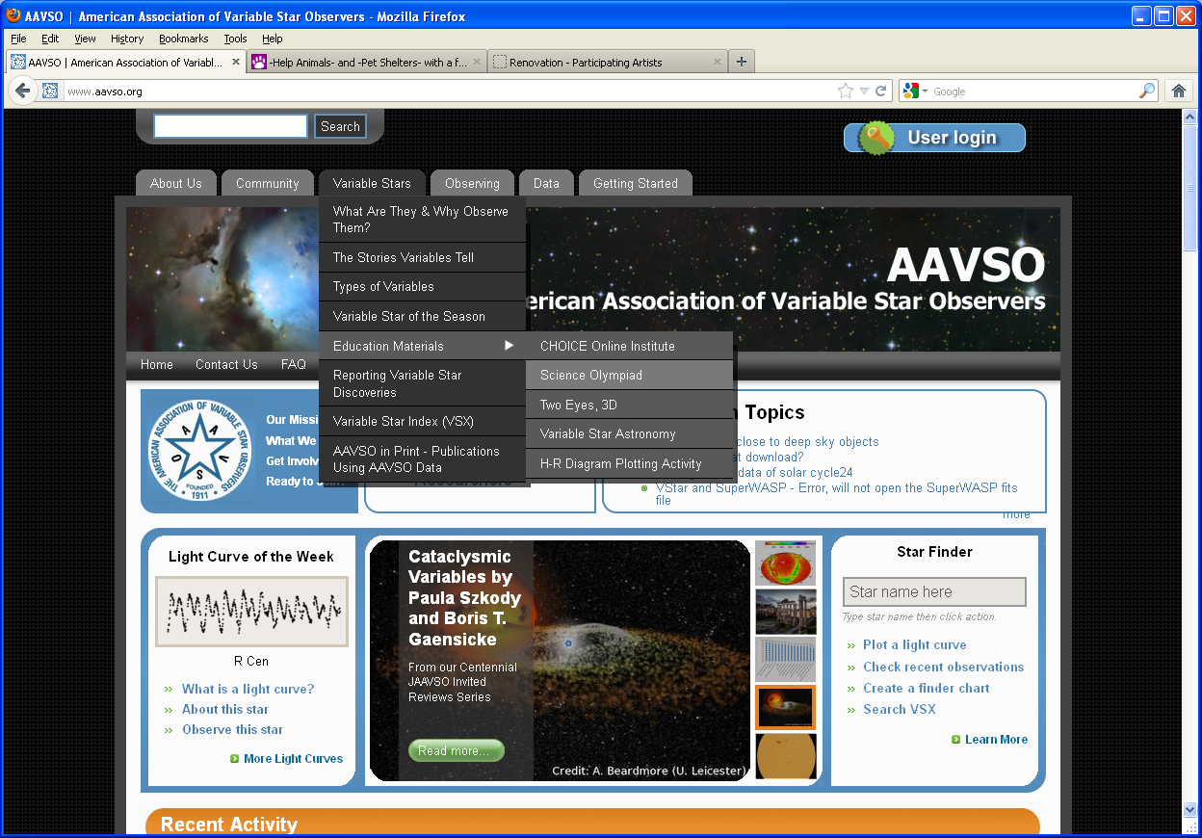
aavso.org

Slide 4
ASTRONOMY, Division C
DESCRIPTION: Students will demonstrate an understanding of the basic concepts of mathematics and physics relating to stellar evolution and variable stars.
A TEAM OF UP TO: 2 APPROXIMATE
TIME: 50 minutes
THE COMPETITION: Each team is permitted to bring two laptops, or two 3-ring binders, or one laptop computer and one 3-ring binder (any size) containing information in any form from any source. The materials must be 3-hole punched and inserted into the rings (notebook sleeves are allowable). Each team member is permitted to bring a programmable calculator. No Internet access is allowed.

Slide 5
Using information which may include Hertzsprung-Russell diagrams, spectra, light curves, motions, cosmological distance equations and relationships, stellar magnitudes and classification, multi-wavelength images (X-ray, UV, optical, IR, radio), charts, graphs, animations and DS9 imaging analysis software, participants will be asked to answer questions relating to:
a.
The processes and stages of stellar evolution, with an emphasis on the following:
protostars, T Tauri variables, Cepheid variables, semiregular variables, red supergiants, Mira variables, RR Lyrae variables, neutron stars, magnetars, pulsars, X-ray binaries, dwarf & recurrent novas, S Doradus variables, Type II & Type Ia supernovas.
b.
Use Kepler’s laws, rotation and circular motion to determine answers relating to the orbital motions of binary and multiple star systems; use parallax, spectroscopic parallax, and the distance modulus to calculate distances to Cepheid, RR Lyraes, & Type Ia supernovas.
c.
Students should be knowledgeable about the properties and characteristics of the stages of
stellar evolution listed above, including spectral features and chemical composition,
luminosity, blackbody radiation, color index (B-V), and H-R diagram transitions.
d.
Students will be asked to identify, know the location, be knowledgeable about, and/or
answer questions relating to the three content areas outlined above for the following
Objects: Mira, W49B, Tycho’s SNR, Vela SNR, G1.9+0.3, Eta Carinae, SS Cygni, T Tauri,
GRS 1915+105, 47 Tucanae, The Trapezium, T Pyxidis, Abell 30, RX J0806.3+1527,
V1647 Ori, V1, NGC 1846, NGC 3132

Slide 6
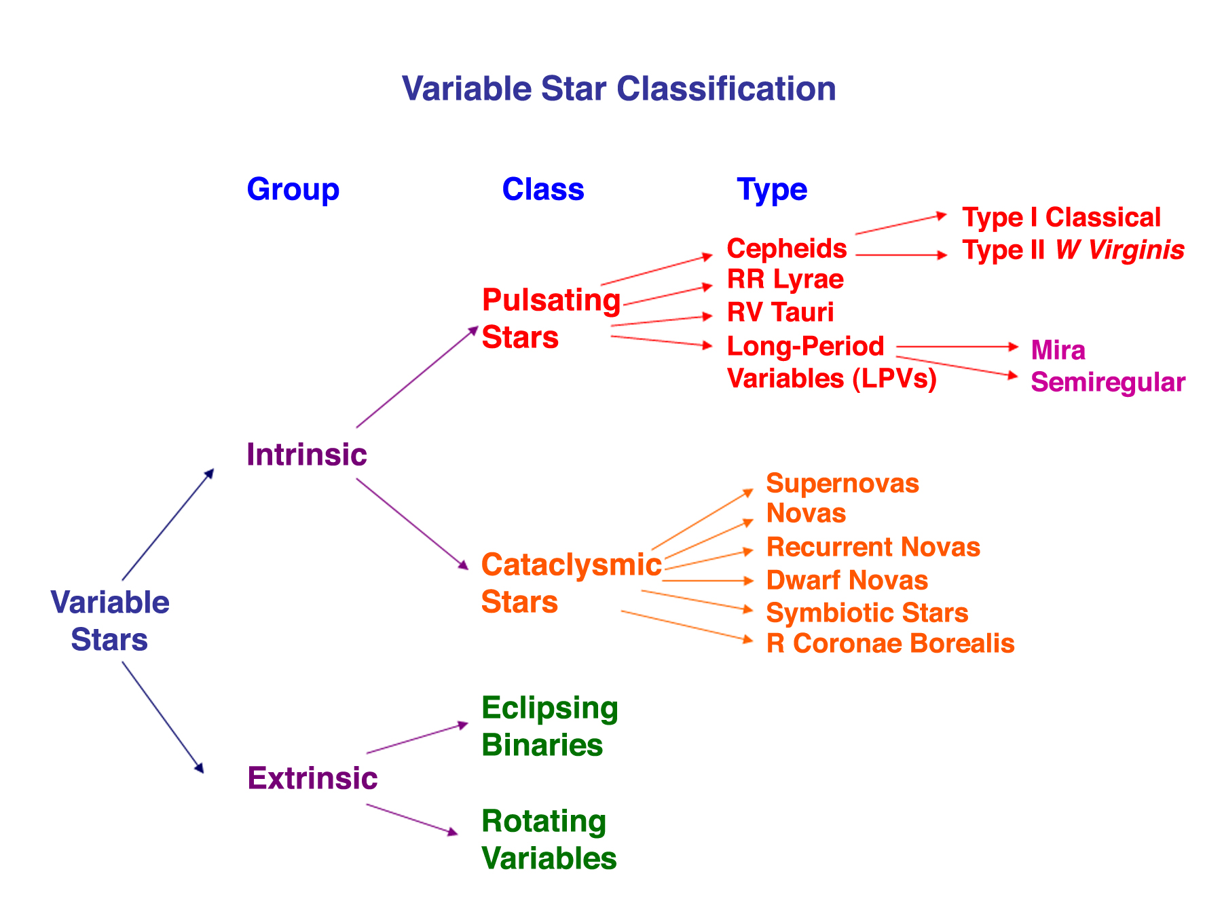
T Tauri
S Doradus
Eruptive

Slide 7
Deep Sky Objects:
A. Pulsating Variable Stars
1) Mira – Mira variable (Long Period Variable)
2) V1 – Cepheid variable
B. Eruptive Variable Stars
1) T Tauri –T Tauri variable star
2) V 1647 Ori – T Tauri variable star
3) Eta Carinae – S Doradus variable star (Luminous Blue Variable)
C. Cataclysmic Variable Stars
1) W49B – Type II supernova with black hole
2) Vela – Type II supernova with pulsar
3) Tycho’s SNR – Type Ia supernova
4) G1.9+0.3 – Type Ia supernova
5) SS Cygni – dwarf nova
6) T Pyxidis – recurrent nova
D. X-Ray Binaries
1) GRS 1915+105 – black hole with companion
Others:
1) J0806.3+1527 – two white dwarf binary system
2) Abell 30 & NGC 3132 – planetary nebulas
3) 47 Tucanae & NGC 1846 – globular clusters
4) The Trapezium – stellar nursery

Slide 8
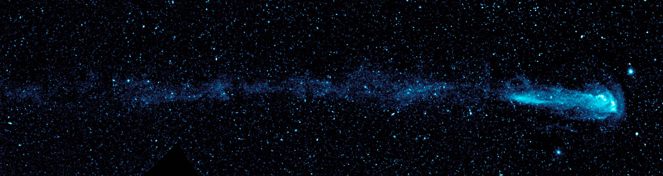
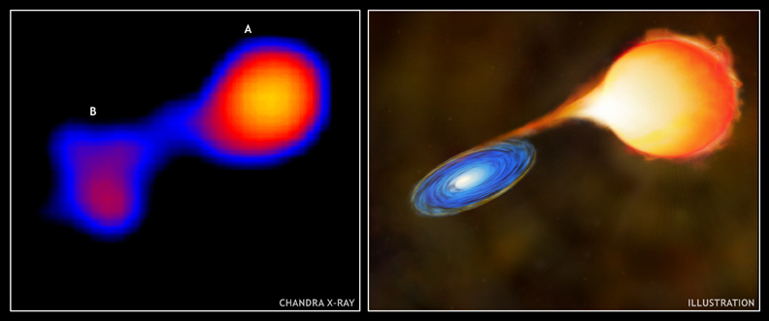
Pulsating Variable Stars: Mira – Mira variable

Slide 9
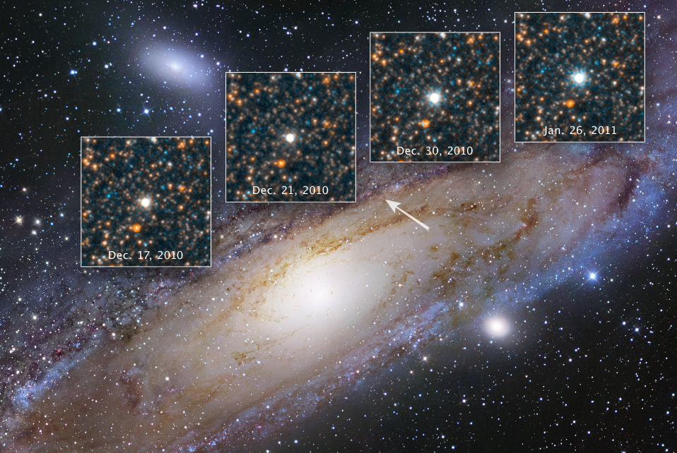
Pulsating Variable Stars: V1 – Cepheid

Slide 10
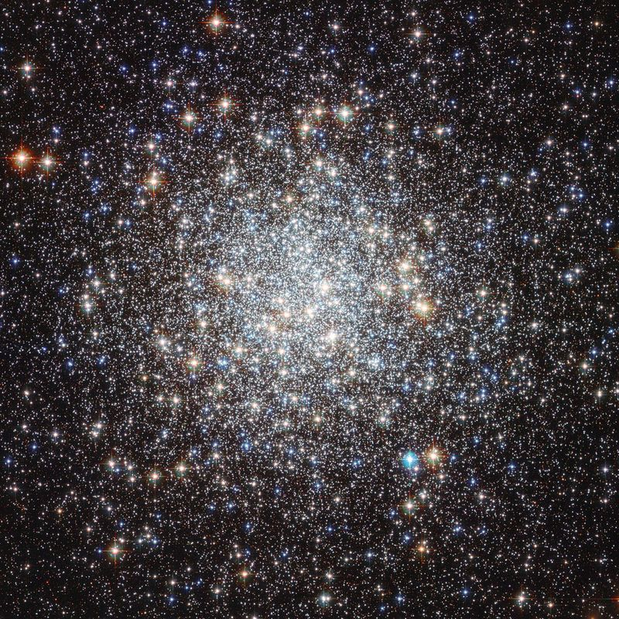
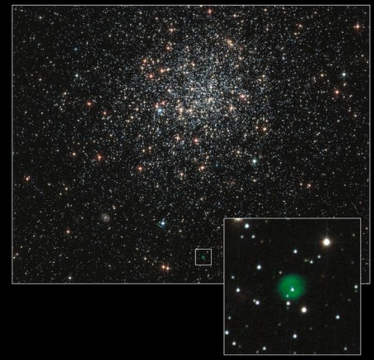
Globular Clusters & RR Lyrae Variables
47 Tucanae
NGC 1846

Slide 11
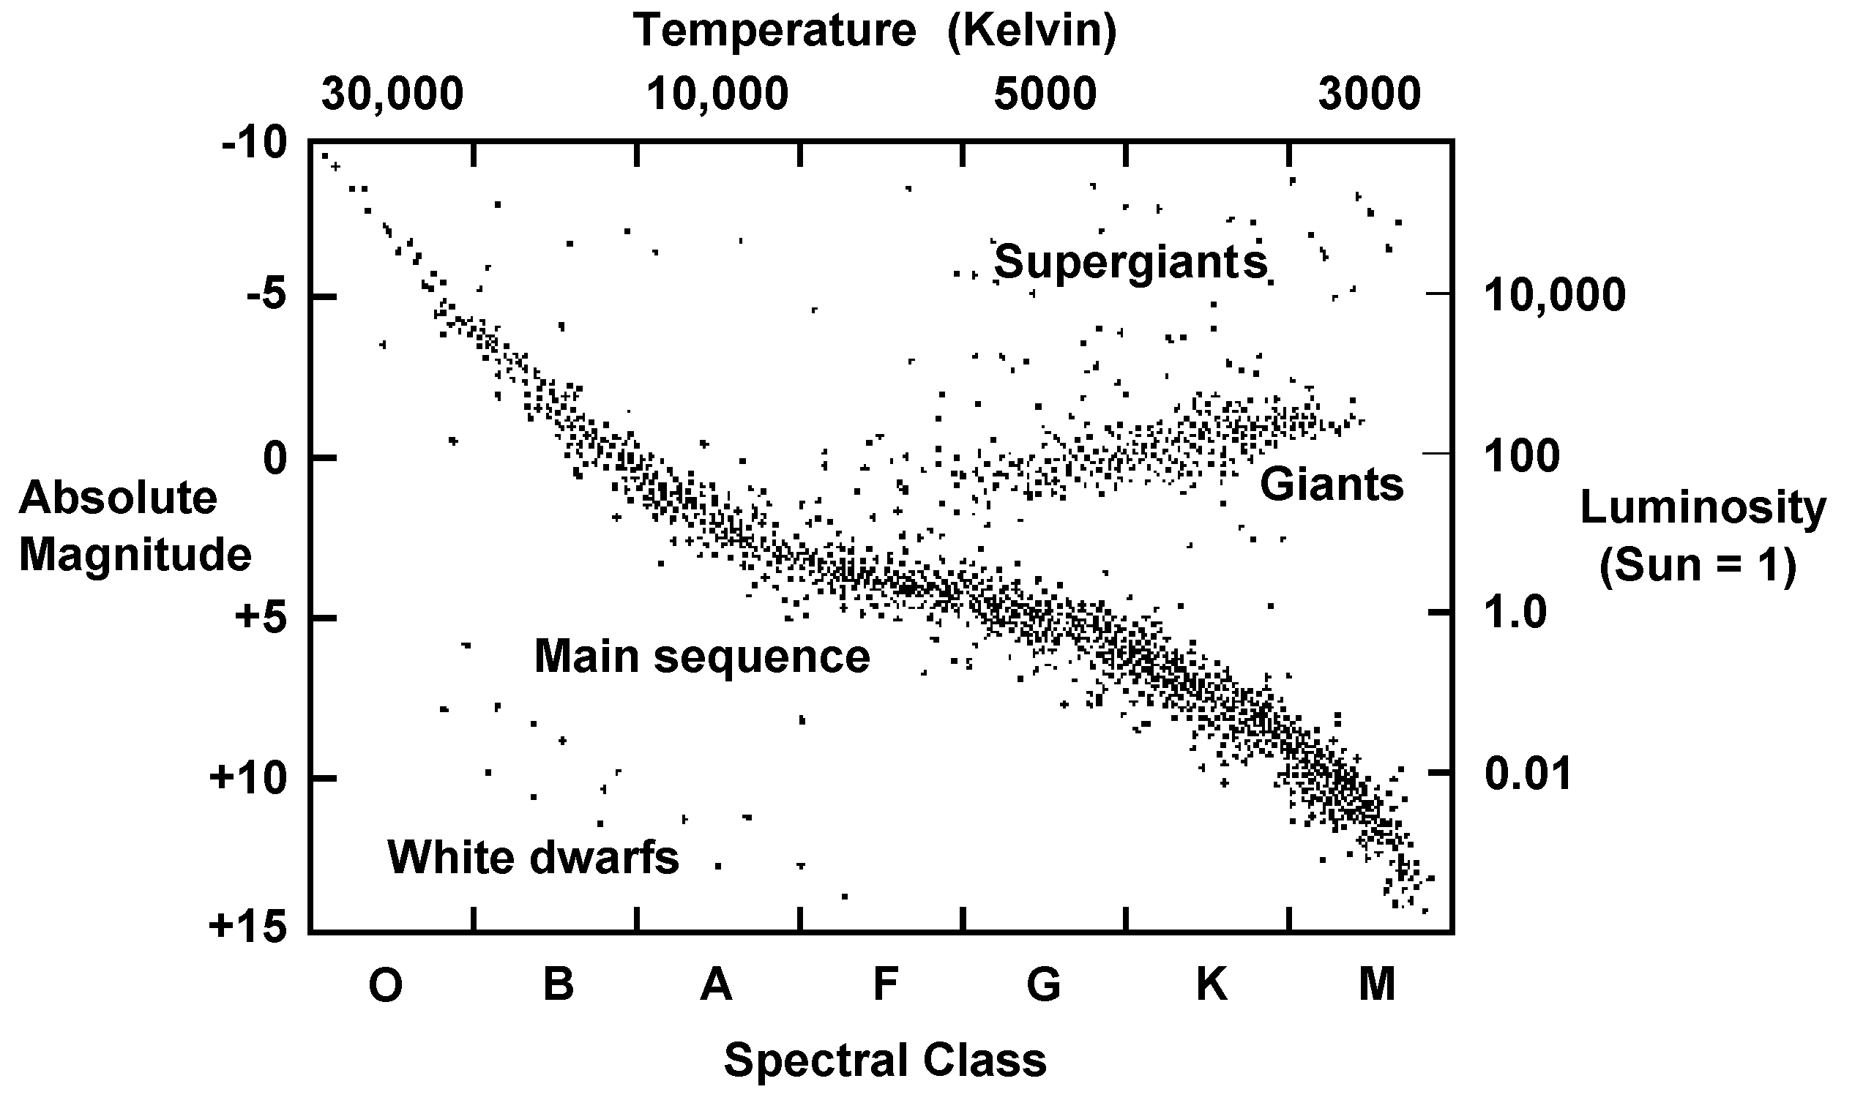
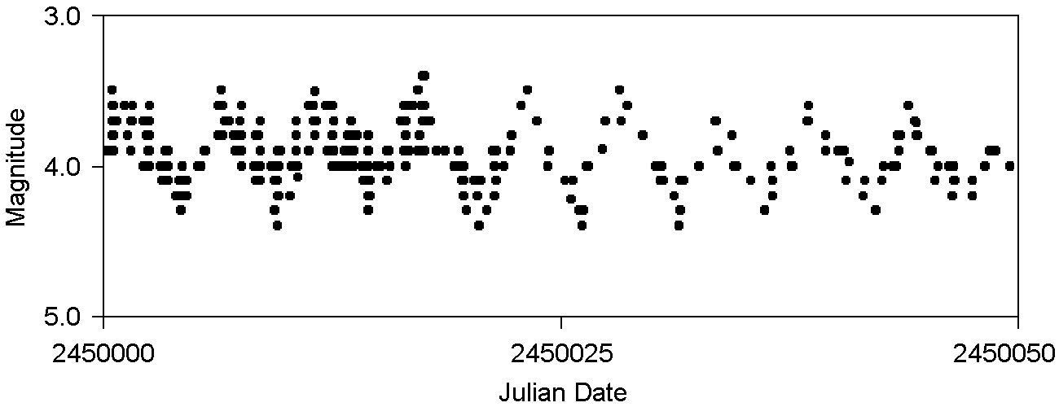
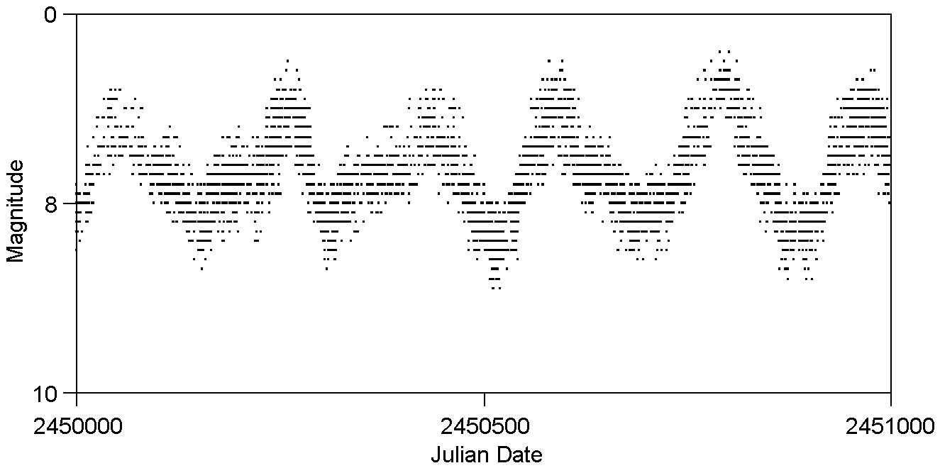
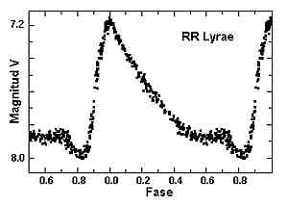
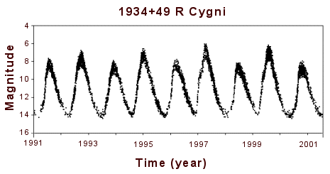
Semiregular Instability Strip
Cepheid Instability Strip
RR Lyrae
Instability
Strip
Mira
Instability Strip

Slide 12
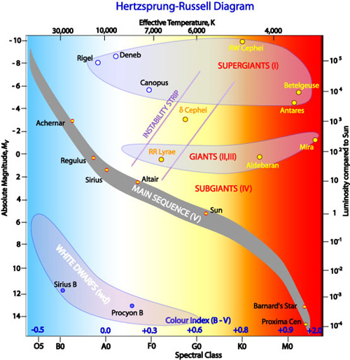
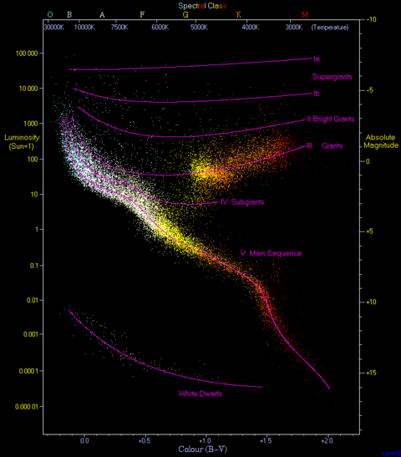
Color Index & Color Magnitude H-R Diagrams
UBV Photometric System

Slide 13
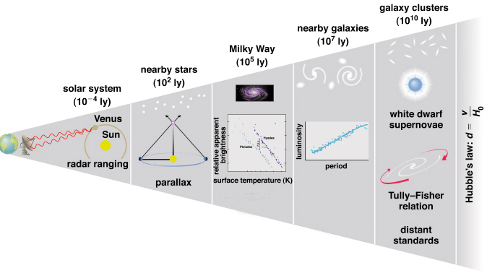
Cosmological Distances
RR Lyrae
Cepheids

Slide 14
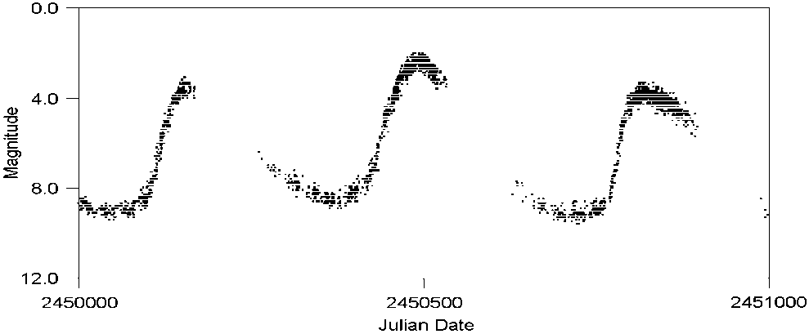
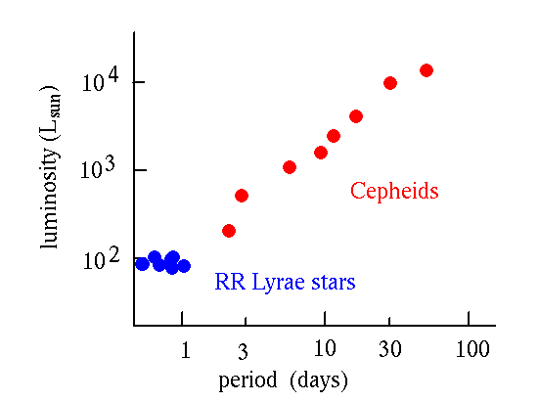

Cepheid & RR Lyrae Variable Stars:
Period-Luminosity Relationship and The Distance Modulus
M_{v} = m - 5log10 (r)
10
M_{vsun} -M_{v}* = 2.5 log L*/L_{sun}

Slide 15
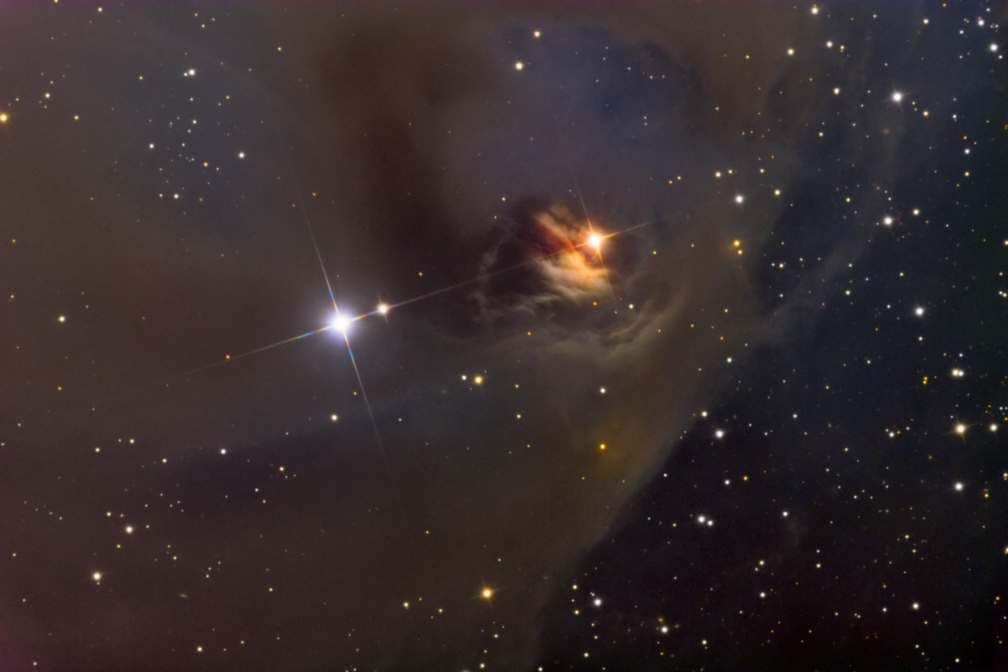
Eruptive Variable Stars: T Tauri – T Tauri variable

Slide 16
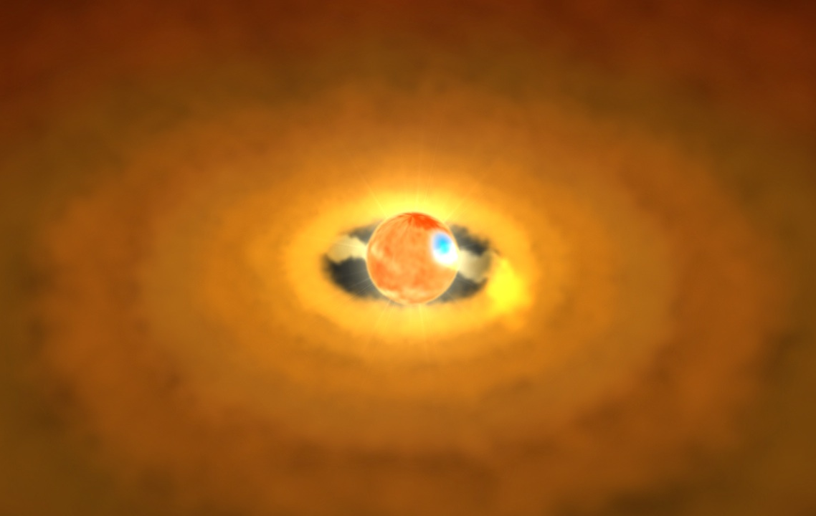
Eruptive Variable Stars: V 1637 Ori – T Tauri

Slide 17
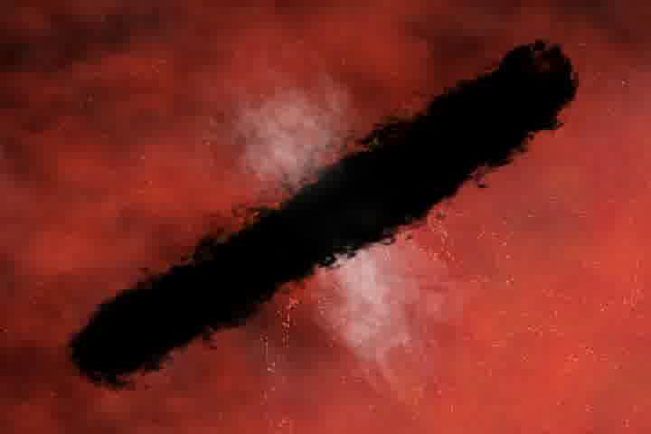

Slide 18
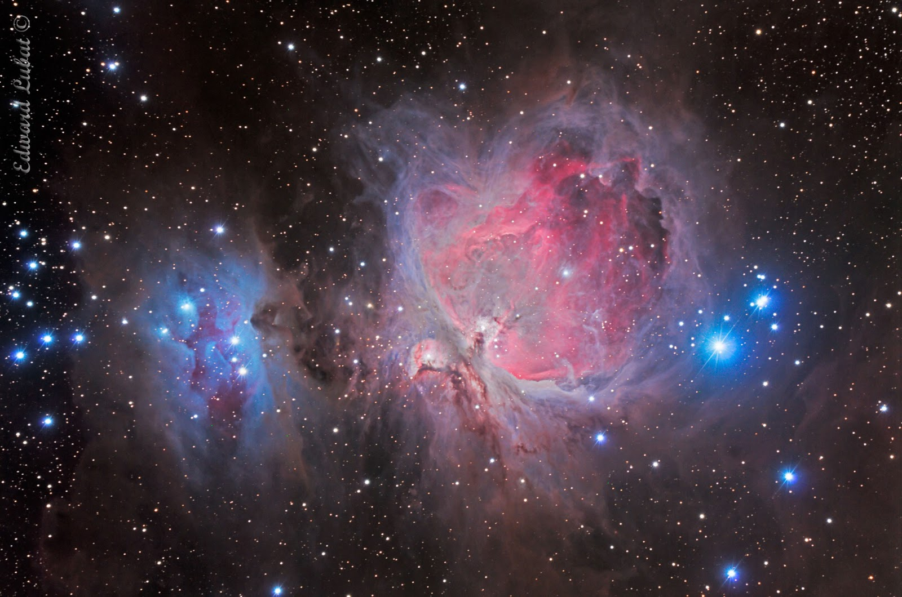
Stellar Nursery – The Trapezium

Slide 19
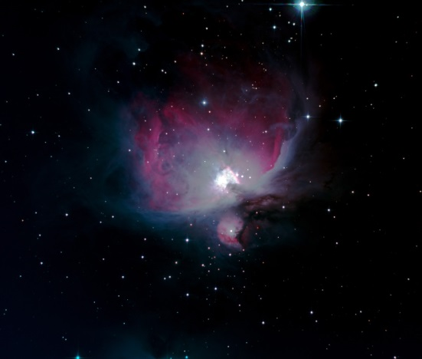
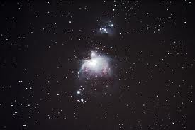
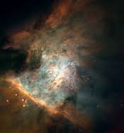
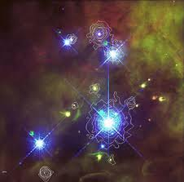
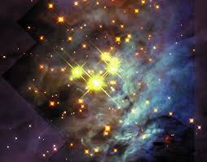
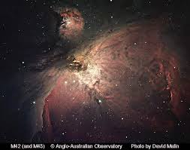
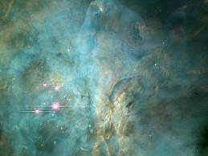
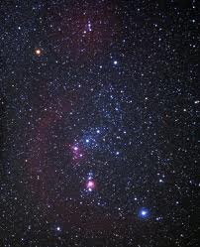
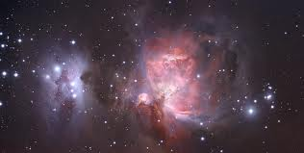
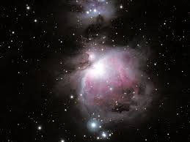

Slide 20
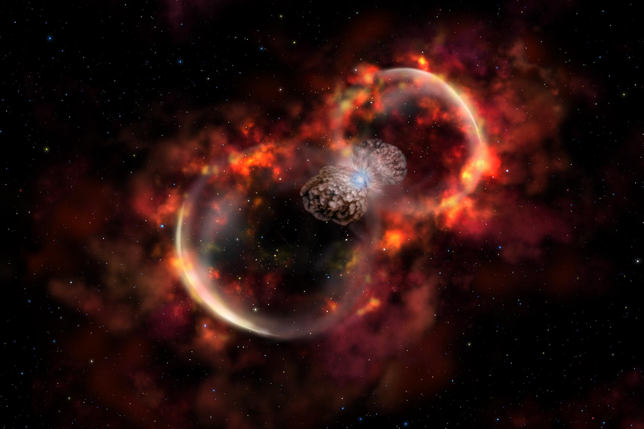
Eruptive Variable Stars: Eta Carinae – S Doradus
(Luminous Blue Variable)

Slide 21
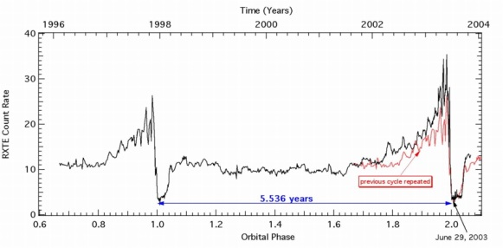
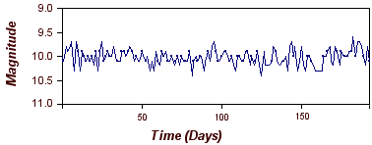
Blue Luminous Variables
T-Tauri

Slide 22
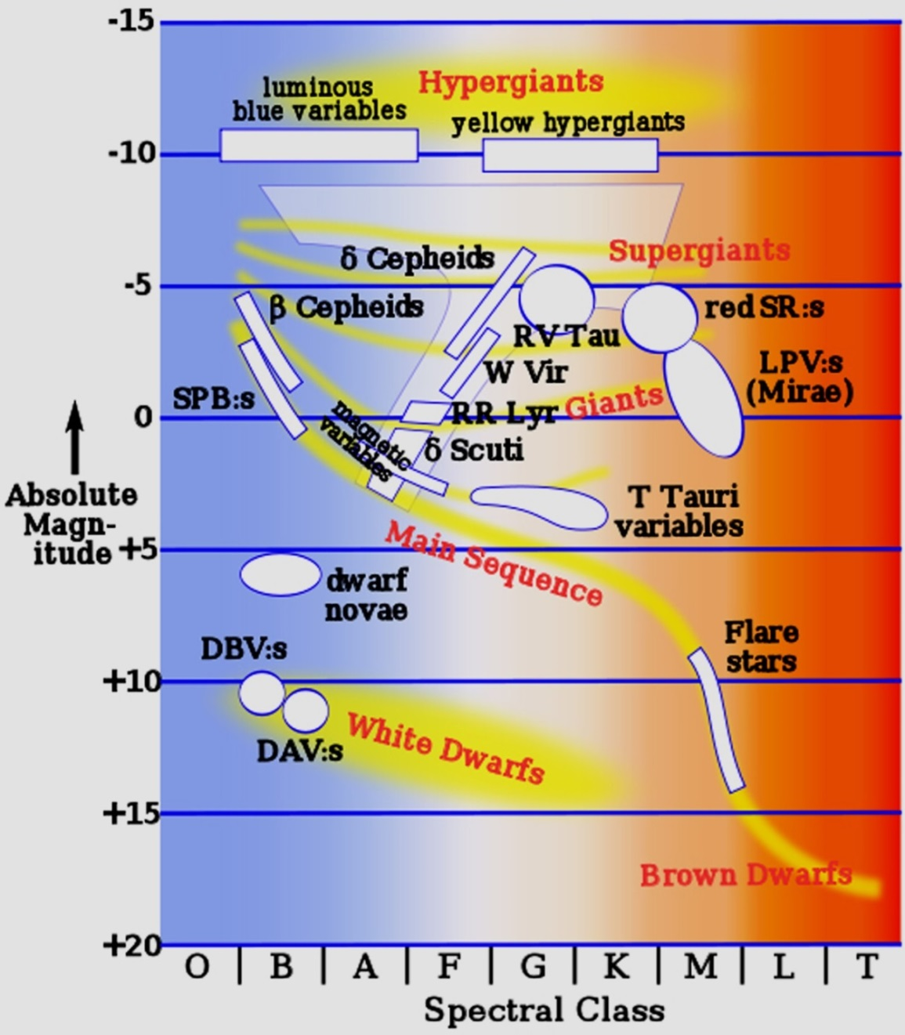
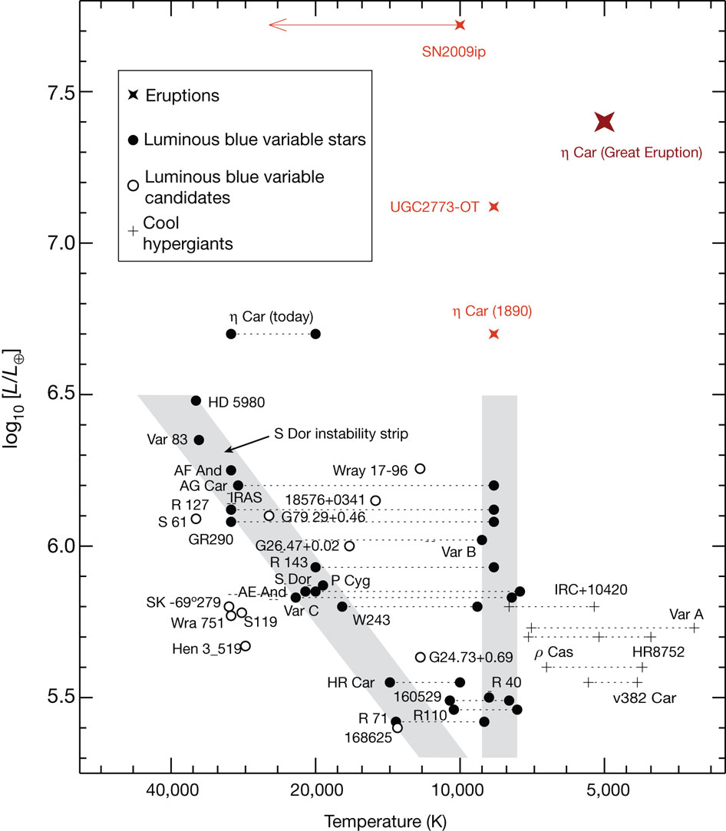
Eruptive Variables
X

Slide 23
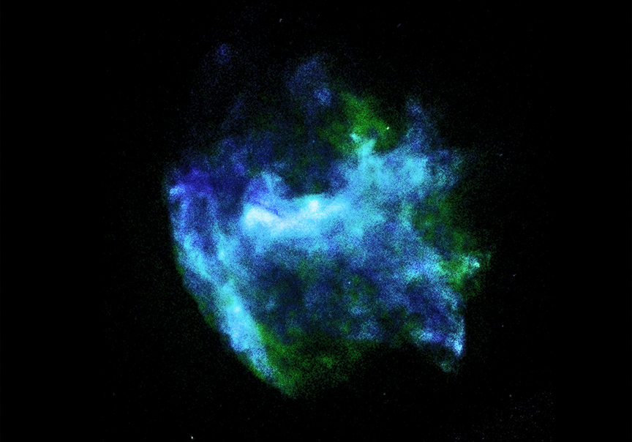
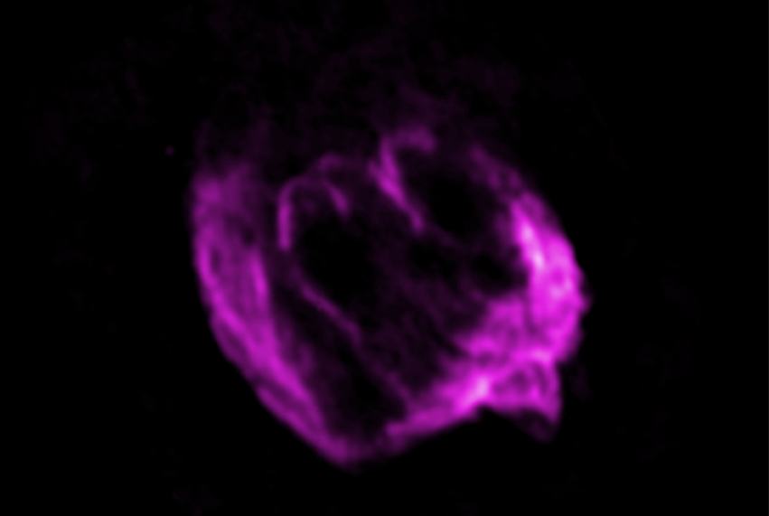
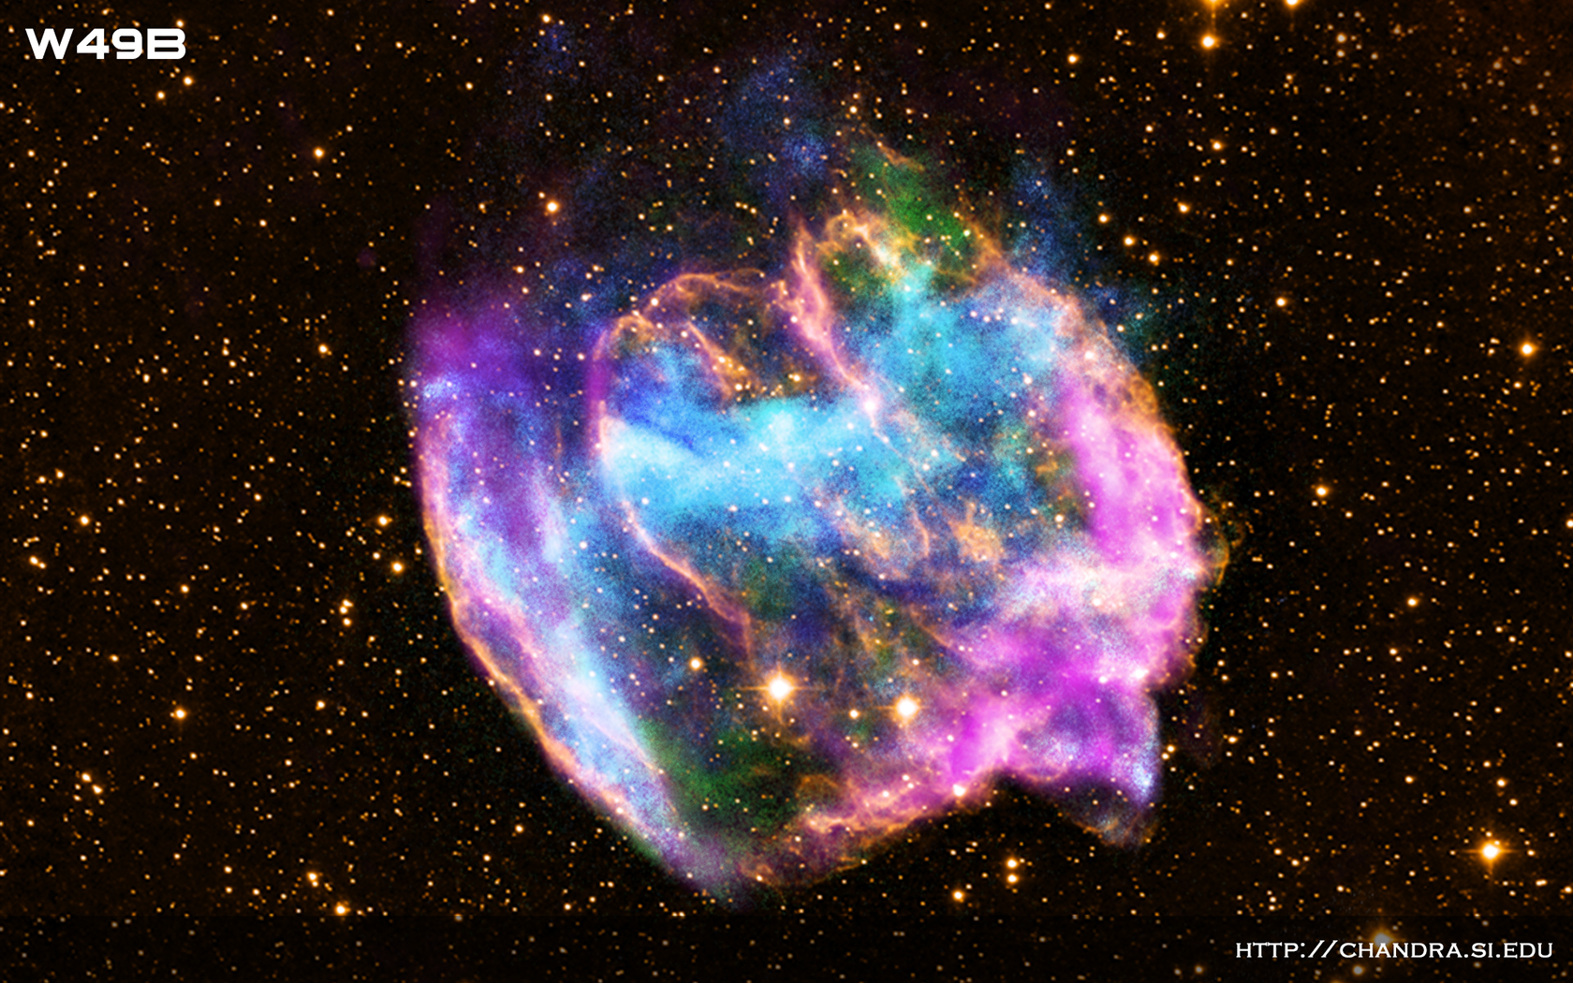
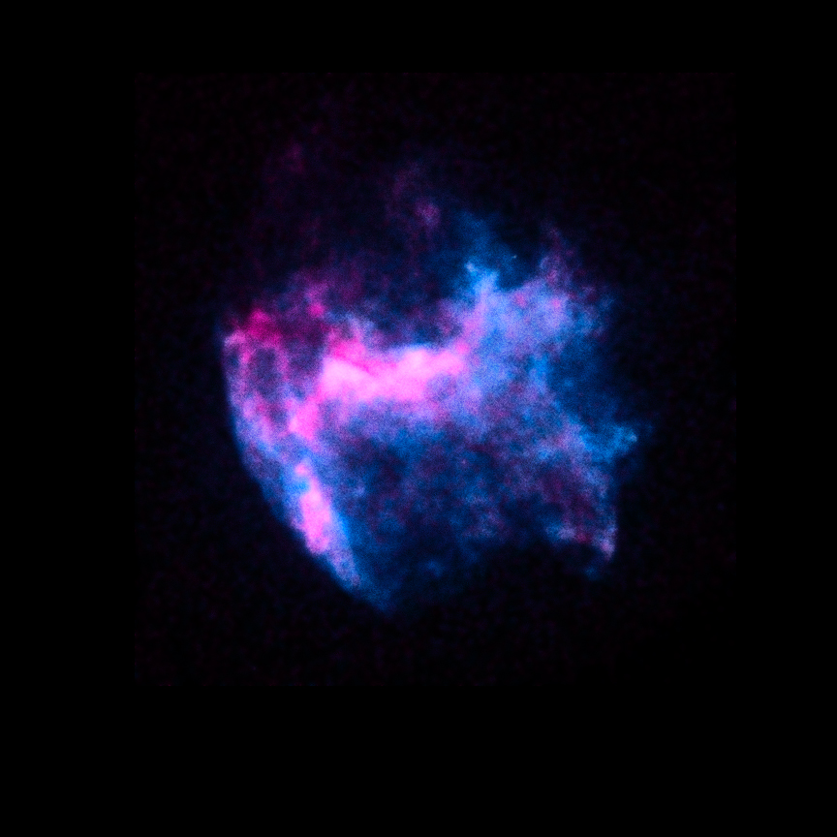
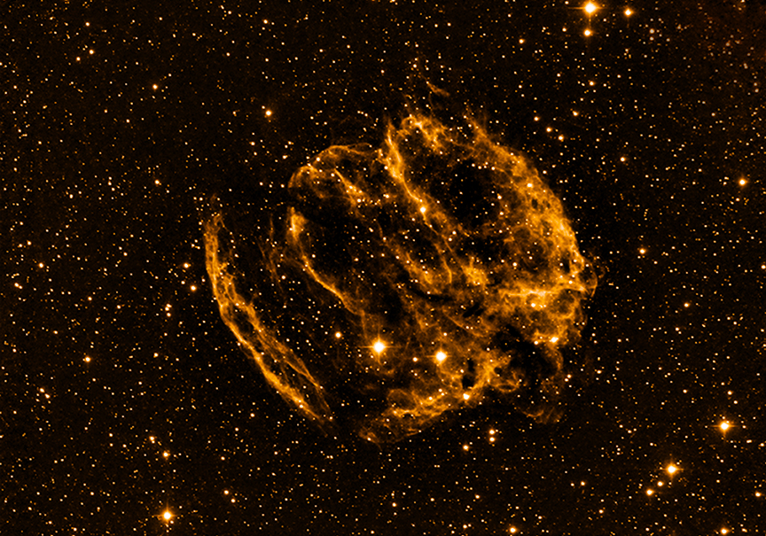
Cataclysmic Variable Stars: W49B – Type II Supernova

Slide 24
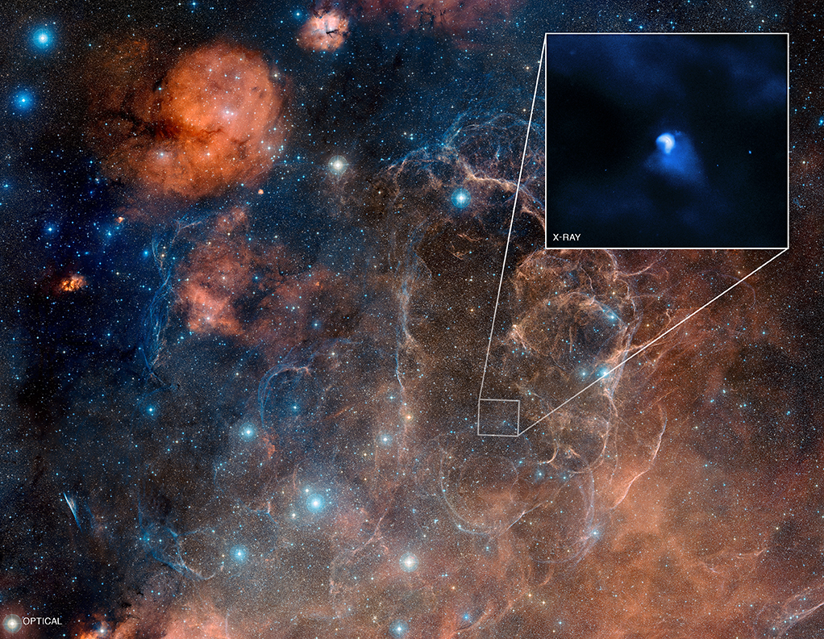
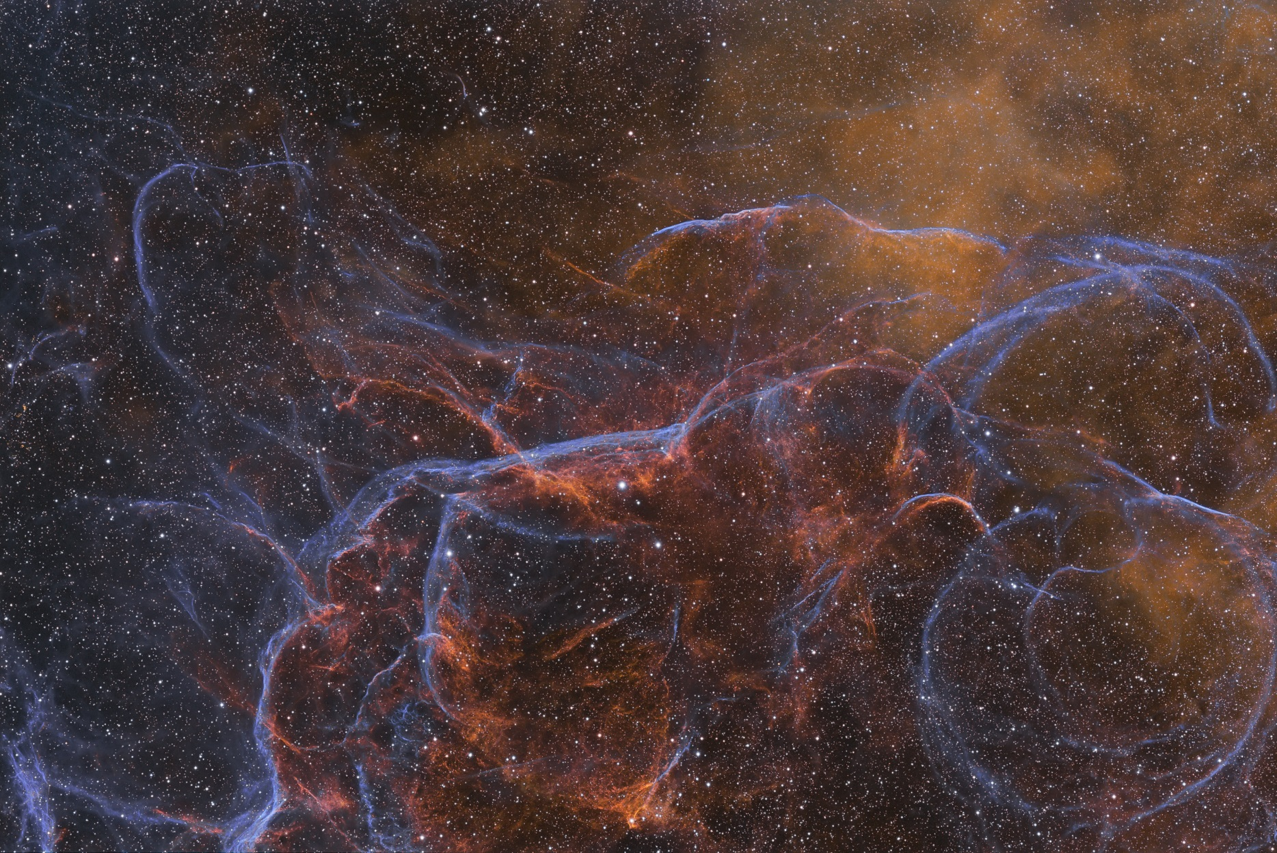
Cataclysmic Variable Stars: Vela – Type II Supernova

Slide 25
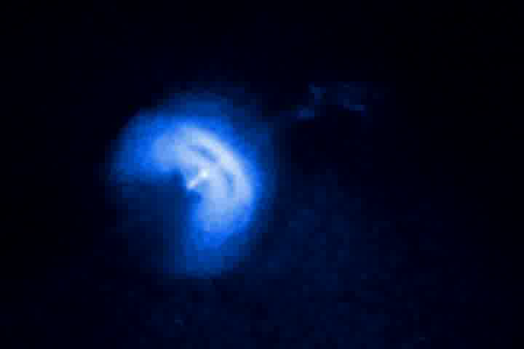
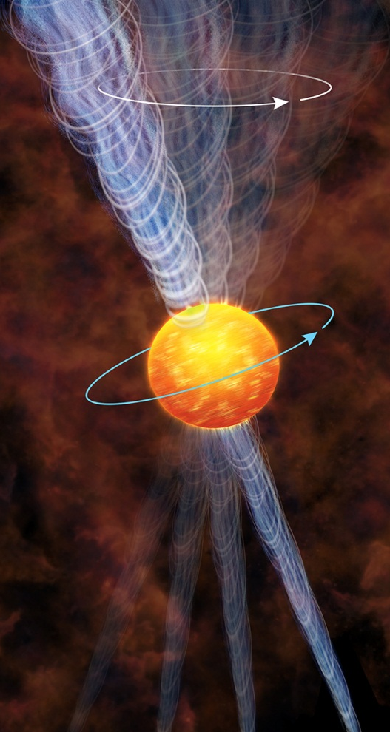

Slide 26
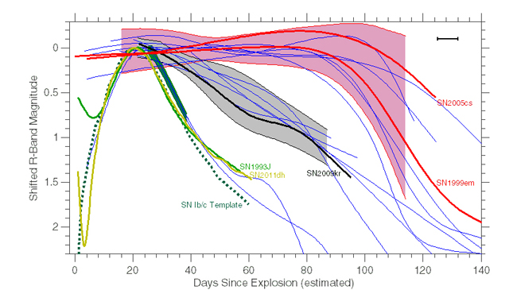
Type II Supernova Light Curves

Slide 27
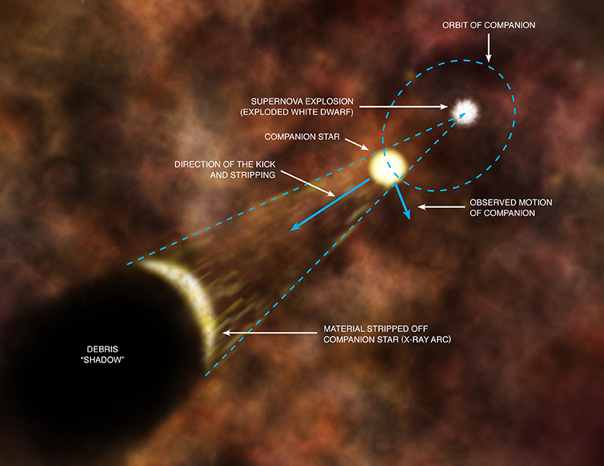
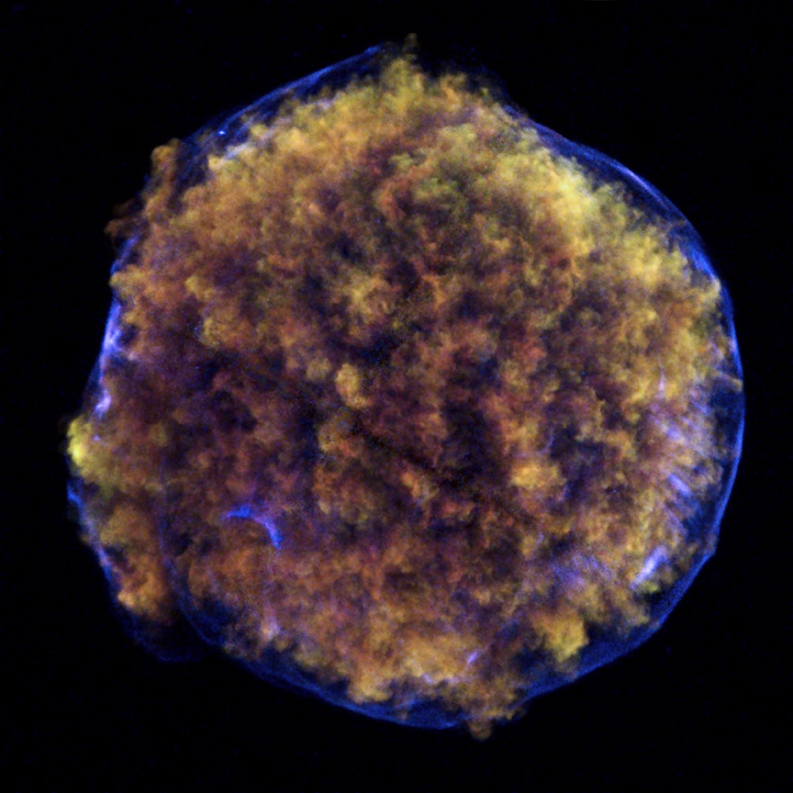

Cataclysmic Variable Stars: Tycho’s SNR – Type Ia Supernova

Slide 28

Cataclysmic Variable Stars: G1.9+0.3 – Type Ia Supernova

Slide 29




Slide 30
Cosmological Distances
The Distance Modulus:
M_{v} = -19.5 for Type Ia
Type Ia Supernovas
RR Lyrae
Cepheids

Slide 31

Type Ia Light Curve with Multiple Filters

Slide 32


Slide 33


Cataclysmic Variable Stars: SS Cygni – Dwarf Nova (U Gem)

Slide 34



Cataclysmic Variable Stars: T Pyxidis – Recurrent Nova

Slide 35


SS Cygni
T Pyxidis

Slide 36

Light Curves
Cepheid
T Tauri
Supernova
Recurrent
Semiregular
RR Lyrae
Mira
Dwarf Nova
Nova

Slide 37




Phase Diagrams
JD today at 1:00 PM – 2,456,542.041667
1) Cepheid light curve
2) Superposition of periods
3) Same data plotted twice
4) Same data starting at maxima

Slide 38






O – C Diagrams
Perfectly Periodic
Perfectly Periodic
Perfectly Periodic
Correct Epoch
Change in Period
Correct Epoch
Correct Period
Wrong Period
**True Period Shorter
then Lengthens
**True Period longer
Perfectly Periodic
Periodic
NOT Perfectly Periodic
Perfectly Periodic
Period Unchanged
Epoch has Changed
Correct Period
Wrong Epoch
Correct Period
Different Period
Each Day
Wrong Epoch
** The slope of each line is the difference between its period and the estimated period.

Slide 39



MISLEADING H-R Diagrams
X
X
X
X

Slide 40


X-Ray Binary: GRS 1915+105

Slide 41


Slide 42




Slide 43

Binary System: J0806.3+1527

Slide 44

Planetary Nebula – Abell 30

Slide 45

Planetary Nebula – NGC 3132
(Eight-Burst or Southern Ring Nebula)

Slide 46


Slide 47

Planetary Nebula H-R Diagram Tracks
Fusion NOT Burning!!!!

Slide 48


Slide 49


Twinkle twinkle little star, how I wonder……
…where on the H-R diagram you are….

Slide 50


Slide 51

Blackbody Radiation

Slide 52


Slide 53



Spectra

Slide 54




Spectra
SS Cygni
Z Cam

Slide 55


Sun
Image
Sun
Plot
Hydrogen
Balmer Lines
Fraunhofer
He, Ca, H
Lines

Slide 56


Summary of the Classification of Stars
Spectral Class | Temperature (ºK) | Strength of Balmer lines | Other lines to look for
O | 30,000 - 60,000 | weak or not visible | Ionized He (4540Å)
B | 10,000 - 30,000 | moderate
A | 7,500 - 10,000 | strong
F | 6,000 - 7,500 | weak | Ionized Ca (3930Å, 3970Å) strong compared to neutral H (4340Å)
G | 5,000 - 6,000 | weak | Ionized Ca (3930Å, 3970Å) strong compared to neutral H (4340Å)
K | 3,500 - 5,000 | weak or not visible | Many lines, neutral Ca 4230 Å
M | < 3,500 | not visible | Many lines

Slide 57



Stellar Radiation Laws:
Planck’s Law
Wien’s Law
Stefan-Boltzmann’s Law
(λ_{max} = 2.9 x 10⁷ /T)
L = 4πR²σT⁴

Slide 58
Basic Equations and Relationships
The Distance Modulus: M = m - 5log₁₀ (r)
10
Kepler’s 3rd Law: (M_{A} + M_{B}) = a³
p²
v = d ; a = v ; 2π a = vP ; F_{c} = ma_{c} ; a_{c} = v² = rω²
t t r
Small Angle Formula: D = αd
206,265
1 pc = 206,265 au = 3.26 ly = 3.08 x 10¹⁶m
1° = 60 arcmin = 60´ ; 1´ = 60 arcsec = 60˝
Inverse Square Law: L = 1/r²
Circumference, Area, Surface Area, and Volume of a Sphere

Slide 59





chandra.harvard.edu
aavso.org
apod.nasa.gov
http://soinc.org
Variable Star Astronomy

Slide 60





Slide 61
National Astronomy Event Supervisors:
Donna Lee Young – donna@aavso.org
Tad Komacek – tkomacek@gmail.com
Rules clarifications:
available at www.soinc.org under event information
Event Preparation:
Read the Event Description for content and allowable resources.
Use the Webinar and PowerPoint for an overview of the content
topics and deep sky objects.
3. Use the Astronomy Coaches Manuel as a guide to collect images
and information for the 2014 competition.
4. Use the APOD, Chandra and AAVSO websites for images and
content.
5. Download the 2013 Astronomy Event from the AAVSO website
to use as a guide for types of questions and for practice.

